Slide 1
Competitive Programming - Lecture 1
Sanyam Garg

Slide 2
CONTAINERS
Anytime you need to operate with many elements you require some kind of container. In native C (not C++) there was only one type of container: the array.
The problem is not that arrays are limited (though, for example, it’s impossible to determine the size of array at runtime). Instead, the main problem is that many problems require a container with greater functionality.
For example, we may need one or more of the following operations:
Add some string to a container.
Remove a string from a container.
Determine whether a string is present in the container.
Return a number of distinct elements in a container.
Iterate through a container and get a list of added strings in some order.

Slide 3
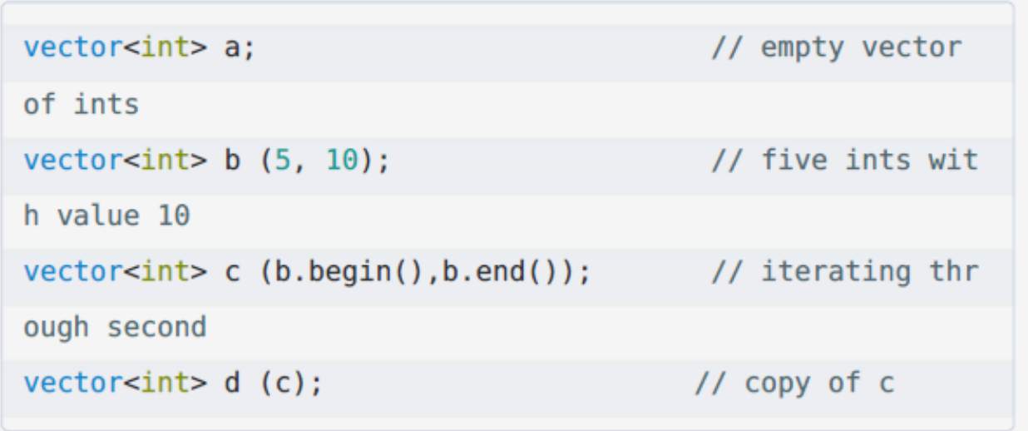

VECTOR
It can be said off as a dynamically allocated array for which we do not need to provide the size at compile time, and whose size is dynamically doubled to fit into the memory.
Main functions :
resize(), size(), capacity(), push_back(), emplace_back(),pop_back()

Slide 4
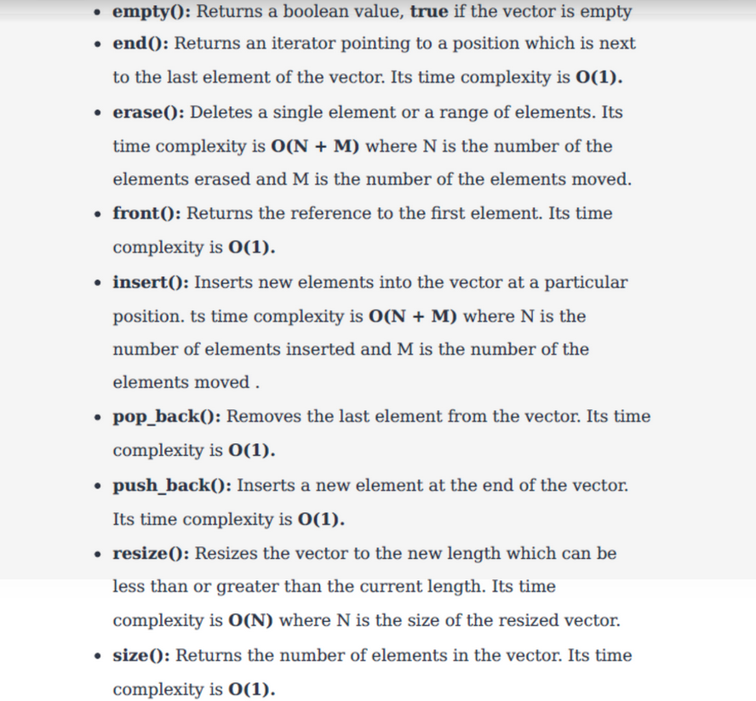
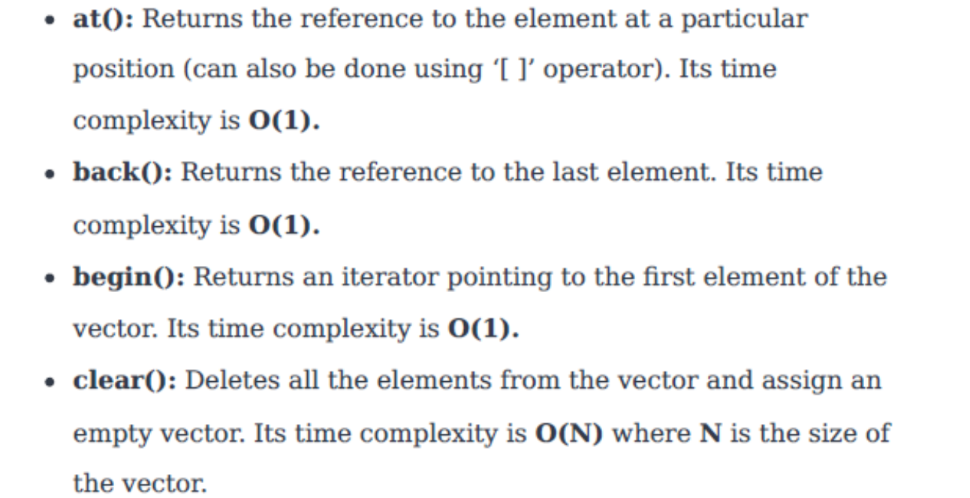
VECTOR FUNCTIONS

Slide 5
PUSH_BACK v/s EMPLACE_BACK
Here are the steps to execute `push_back`:
construct a new (empty) element
add it to the end of the container
copy the argument into the new element in #1
While the steps to execute `emplace_back`:
construct a new element using the argument values
add it to the end of the container
This is the reason why emplace_back is more efficient.

Slide 6
LOWER_BOUND AND UPPER_BOUND
QUICK PROBLEM :
https://www.hackerrank.com/challenges/cpp-lower-bound/problem

Slide 7
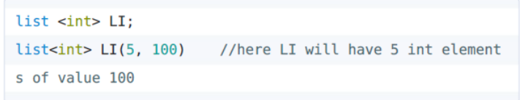
LIST
It is implemented in the backend as a doubly linked list.

Slide 8
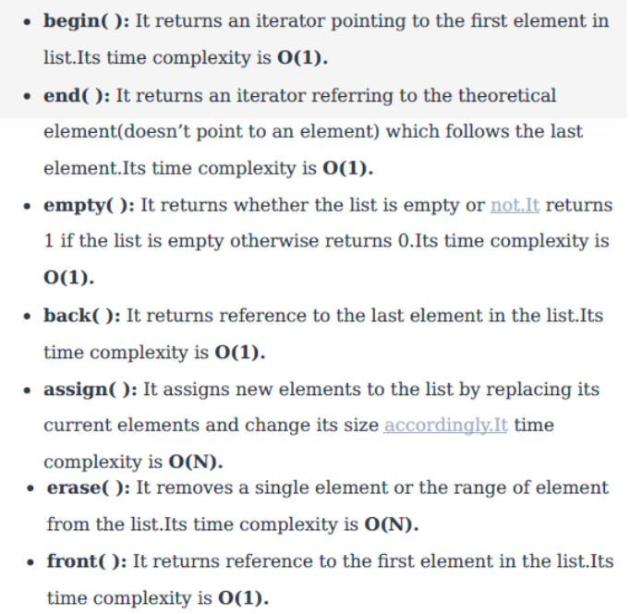
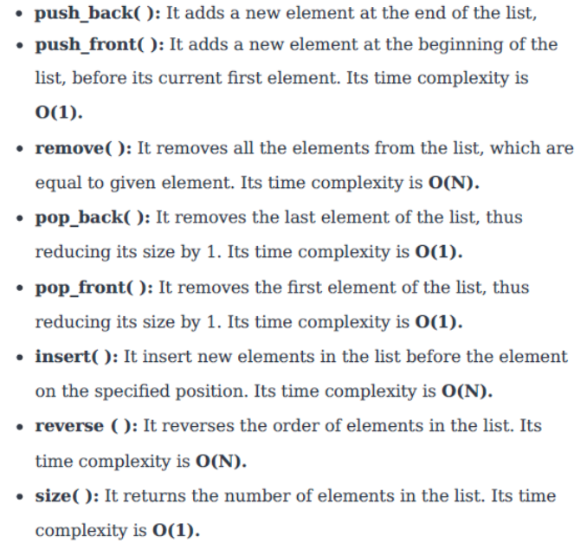
LIST FUNCTIONS

Slide 9
PAIR AND TUPLE
make_pair() or {}
make_tuple() and get <i>(tuple_name)

Slide 10
SET & MULTISET
They are implemented as red black trees in C++. However, the main fact is that multiset can contain duplicate elements whereas a set cannot.

Slide 11
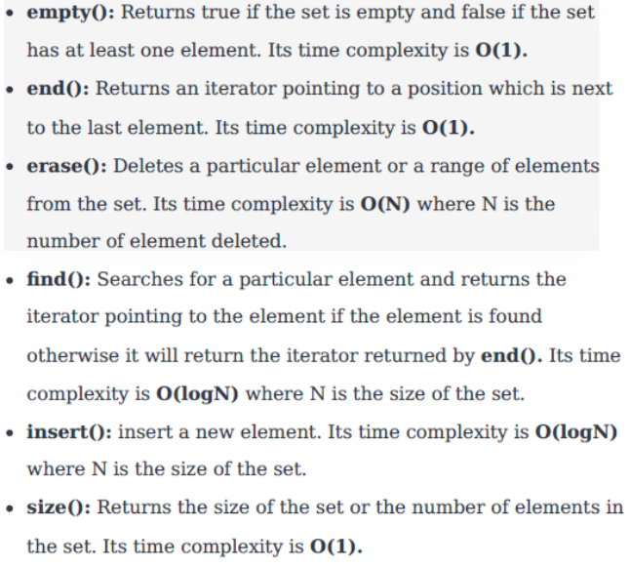
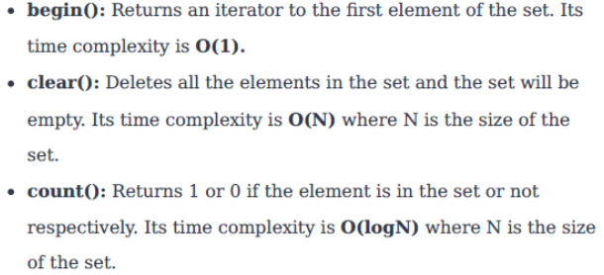
SET FUNCTIONS

Slide 12
MAP
< key, value > pairs stored as an RB-Tree just like a stack. It is sorted on the basis of the key attribute.

Slide 13
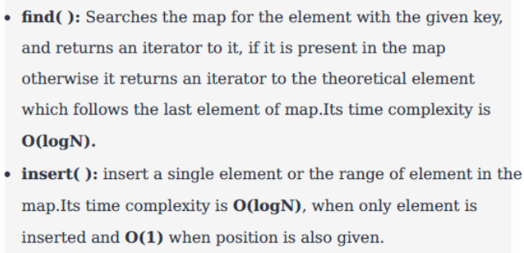
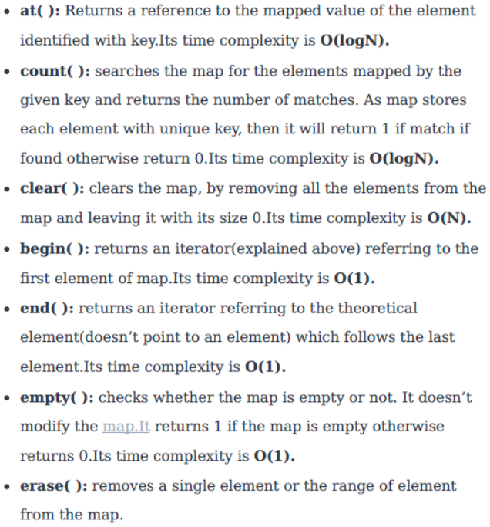
MAP FUNCTIONS

Slide 14
MODIFYING MAP AND SET COMPARATORS

Slide 15
FUN THING REGARDING MAPS
map < int,int > mark;
mark[1] = 2;
cout << mark.size() << endl;
int val = mark[0];
cout << mark.size() << endl;
So we should use mark.find() instead. So the code should go like :
If ( mark.find(0) != mark.end() ) val = mark[0]

Slide 16
QUICK PROBLEM BASED ON STL
https://codeforces.com/problemset/problem/1029/D

Slide 17
DEQUE
https://www.hackerrank.com/challenges/deque-stl/problem
https://www.codechef.com/problems/CHRL4

Slide 18
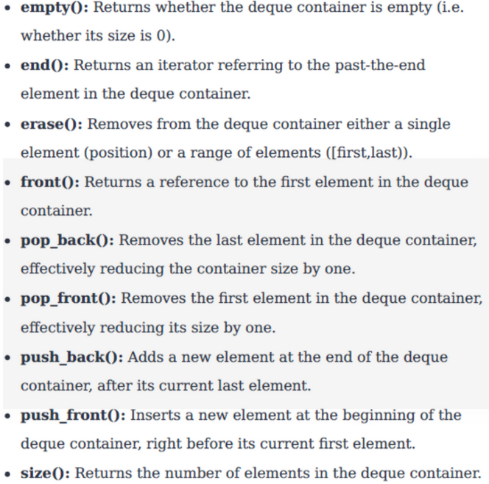
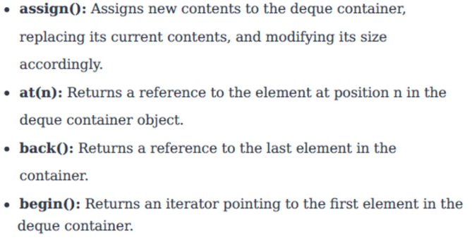
DEQUE
Double - Ended Queue

Slide 19
STACK
push(), pop(), top(), empty(), size()
https://codeforces.com/problemset/gymProblem/101343/H

Slide 20
QUEUE
push(), pop(), front(), empty(), size()

Slide 21
PRIORITY QUEUE
push(), pop() : O(logn)
empty(), size(), top() : O(1)

Slide 22
HOW TO CREATE A GRAPH IN C++
By using either
vector <list>
OR
vector < vector >

Slide 23
MARBLES PROBLEM

Slide 24
UNORDERED_MAP
-> It is a hash table.
-> search complexity is O(1) in the best case and O(n) in the worst case

Slide 25




ALGORITHM

Slide 26
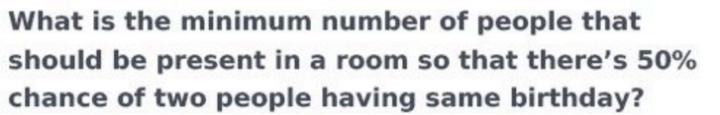
BIRTHDAY PARADOX

Slide 27
BITWISE OPERATORS
&, |, ~ and ^

Slide 28
HOW TO COUNT THE NUMBER OF SET BITS

Slide 29
BITMASKING TO ITERATE OVER ALL SUBSETS
https://codeforces.com/problemset/problem/550/B
https://www.codechef.com/problems/MARCHA1/

Slide 30
PROBLEMS :
UNIQUE NUMBER - 1
UNIQUE NUMBER - 2
UNIQUE NUMBER - 3
SUM OF XOR OF ALL SUBARRAYS

